Slide 1
Solar Driveway
By: Zach Delgado & Dylan Zeiset

Slide 2
How much we need to get started?
We need about $50,000 to get started. Then we could use the money to pay $25,000 to SunPower then $25,000 dollars for us to give to the people. When they get the solar panels because if they conserve energy then get payed.

Slide 3
What Happens without solar panels?
https://climate.nasa.gov/interactives/climate-time-machine

Slide 4
How much does it cost?
The solar panels cost about $25,000 for a little space to a big space it is $40,000.

Slide 5
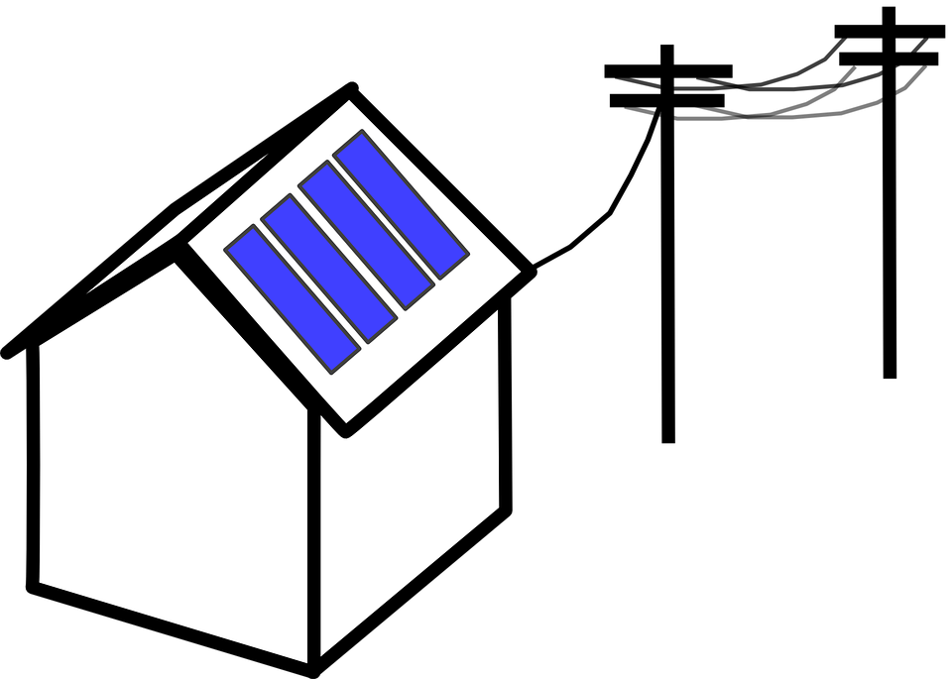
How it works
Instead of having it in the house it should be on the driveway and then the electric would go to the electric lines and your house to use the energy that the solar panels make.

Slide 6
We found are solar panel company at https://www.solarpowerauthority.com/top-solar-companies/

